Slide 1

Customer Shopping Behavior Analysis
Uncovering insights from transactional data to guide strategic business decisions.

Slide 2

Project Overview & Dataset Summary
Project Goal
Dataset Details
Analyze 3,900 purchases
Uncover spending patterns
Identify customer segments
Optimize operations
3,900 Rows, 18 Columns
Demographics, Purchase Details, Behavior
Missing data: 37 in Review Rating

Slide 3
Exploratory Data Analysis (Python)
01
02
03
Data Loading & Exploration
Missing Data Handling
Column Standardization
Imported with pandas, checked structure and summary statistics.
Imputed 'Review Rating' using median by product category.
Renamed columns to snake_case for readability.
04
05
Feature Engineering
Database Integration
Created 'age_group' and 'purchase_frequency_days'.
Loaded cleaned data into PostgreSQL for SQL analysis.

Slide 4

Data Analysis (SQL) - Key Insights
1
Revenue by Gender
Male customers generated $157,890, Female $75,191.
2
High-Spending Discount Users
839 customers used discounts but spent above average.
3
Top 5 Products by Rating
Gloves, Sandals, Boots, Hat, Skirt had highest average ratings.
4
Shipping Type Comparison
Express shipping: $60.48 avg. purchase; Standard: $58.46.

Slide 5

SQL Insights: Subscriptions & Discounts
Subscribers vs. Non-Subscribers
Discount-Dependent Products
Subscribers: 1053 customers, $59.49 avg. spend, $62,645 total revenue.
Hat: 50% discounted purchases
Sneakers: 49.66%
Coat: 49.07%
Sweater: 48.17%
Pants: 47.37%
Non-Subscribers: 2847 customers, $59.87 avg. spend, $170,436 total revenue.

Slide 6
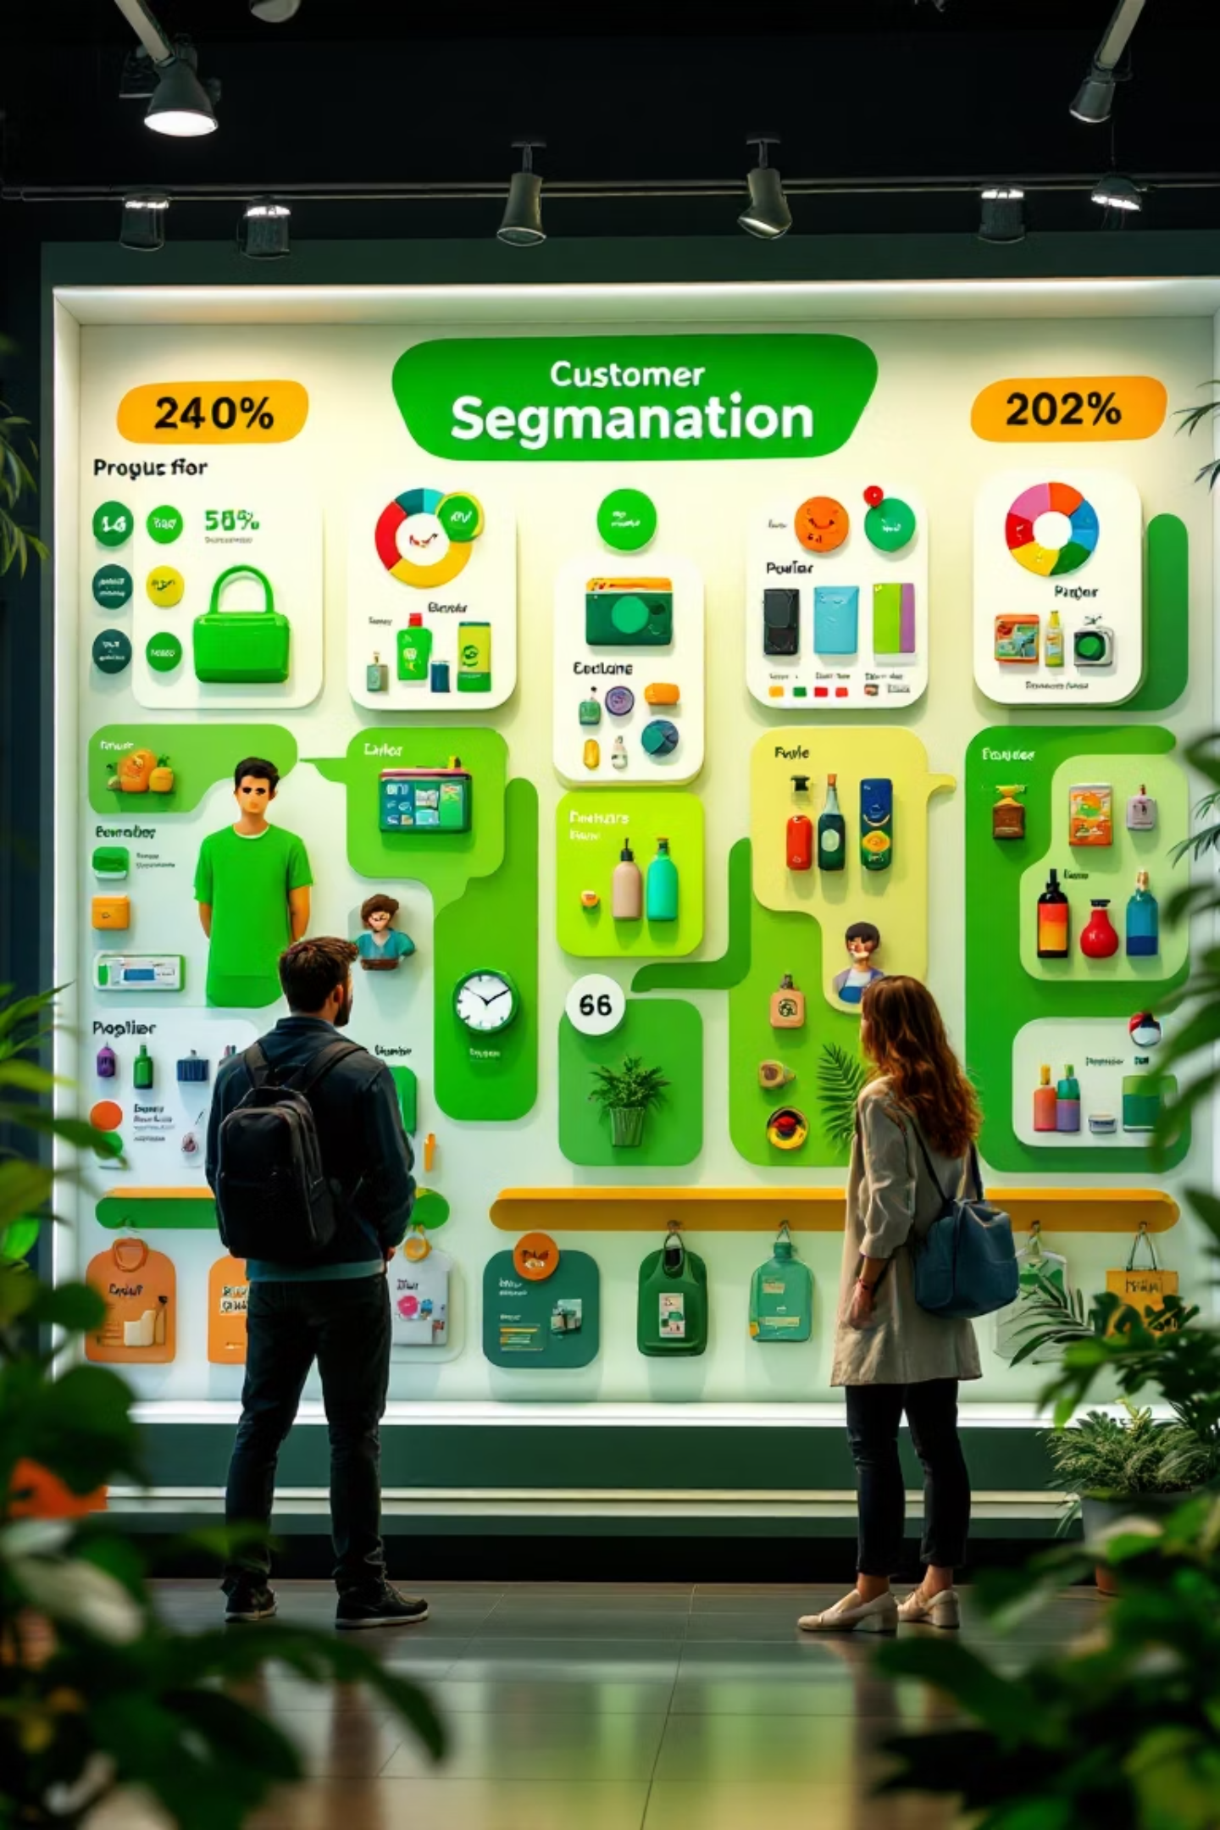
Customer Segmentation & Top Products
Customer Segments
Loyal: 3116
Returning: 701
New: 83
Top Products by Category
Accessories: Jewelry, Sunglasses, Belt
Clothing: Blouse, Pants, Shirt
Footwear: Sandals, Shoes, Sneakers
Outerwear: Jacket, Coat

Slide 7

Repeat Buyers & Age Group Revenue
Repeat Buyers & Subscriptions
Revenue by Age Group
Young Adult: $62,143
Middle-aged: $59,197
Adult: $55,978
Senior: $55,763
Customers with >5 purchases:
No Subscription: 2518
Yes Subscription: 958
Repeat buyers are more likely to subscribe.

Slide 8
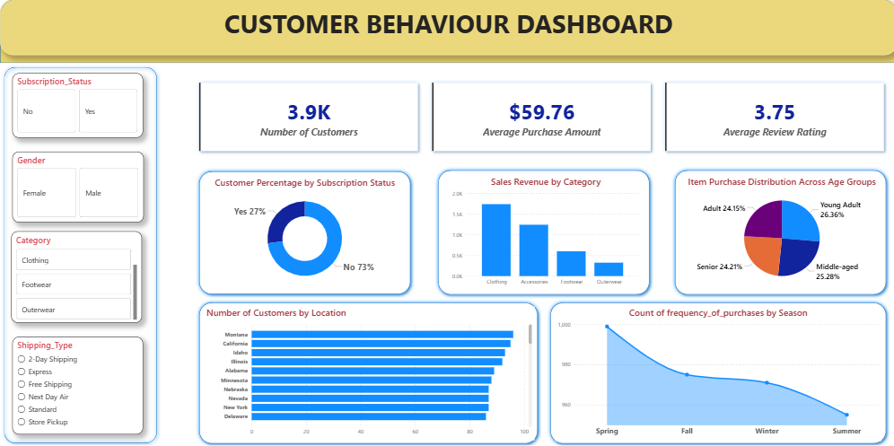
Interactive Power BI Dashboard
Visualizing key metrics for dynamic insights.

Slide 9

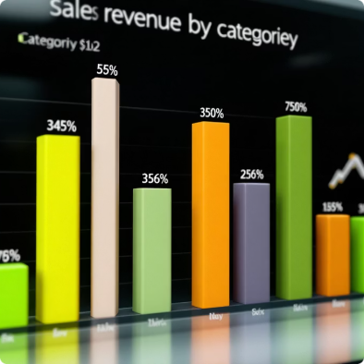

Dashboard Highlights
Subscription Status
Sales Revenue by Category
Item Purchase Distribution
73% No, 27% Yes.
Clothing (1.8K), Accessories (1.2K), Footwear (0.5K), Outerwear (0.3K).
Young Adult (26.36%), Middle-aged (25.28%), Senior (24.21%), Adult (24.15%).

Slide 10

Business Recommendations
Boost Subscriptions
Promote exclusive benefits for subscribers.
Customer Loyalty Programs
Reward repeat buyers to foster loyalty.
Review Discount Policy
Balance sales boosts with margin control.
Product Positioning
Highlight top-rated and best-selling products.
Targeted Marketing
Focus on high-revenue age groups and express-shipping users.

